Slide 1

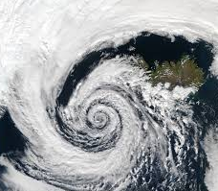
Cyclone
Christy dion
3rd period

Slide 2
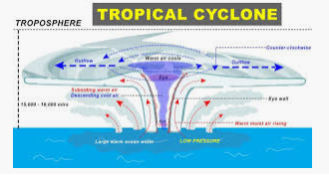
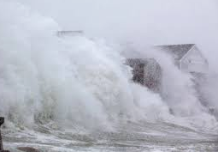
What is this storm like?
Storm formation: is like a hurricane but forms in the “South Pacific & Indian ocean”
Events during storm: it is a storm system characterized by low-pressure center and numerous thunderstorms that produce strong winds and flooding rain.

Slide 3
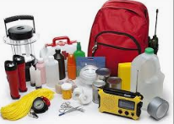
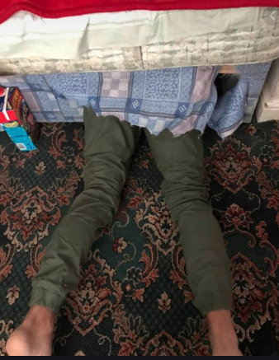
Cyclone Safety
Turn off all electricity (gas, water, unplug appliances.
Emergency kit – keep close
Keep family is strongest part of the house
Listen to radio for updates
If building starts breaking, take cover under a mattress
Evacuate the area
Emergency Kit
  Spare batteries
  First aid kit
  Candles
  Battery operated radio
  Copies of important documents
  Bottled water

Slide 4
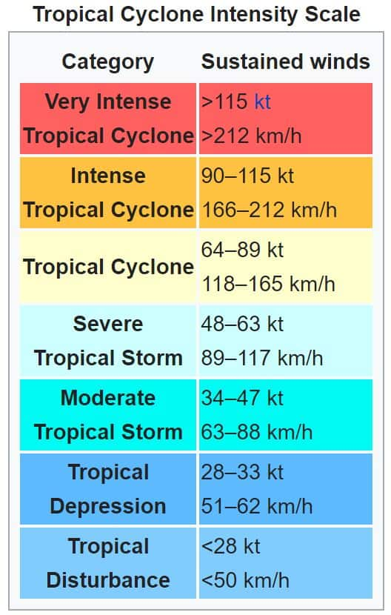
Forecasting
What tool is used to measure?
  Doppler radar
Cyclone prediction:
  Satellites
  Weather radars
  Computers
  Scientists use Potential Intensity to help forecast the strength of cyclones.
  Very difficult to predict because they can change suddenly

Slide 5


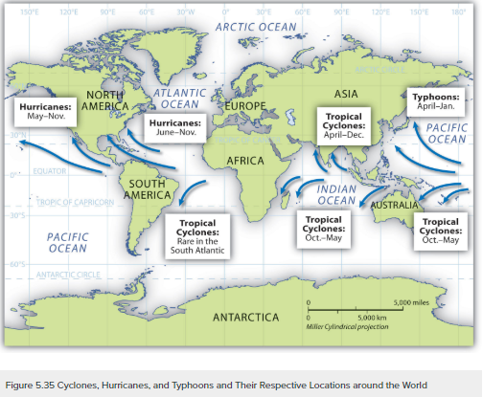
Frequency & locations
Time of year – November 1 – April 30
About 1 a month forms during this period
Based on data, there are about 11 each season
Cyclones occur in the pacific and Indian ocean
In US – Eastern pacific, Hawaii
In other US Areas – called Hurricanes

Slide 6
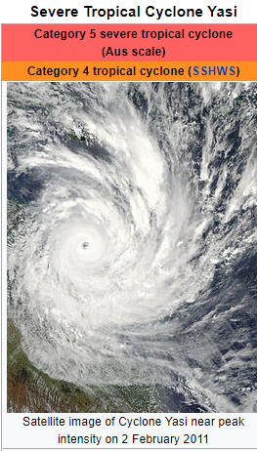
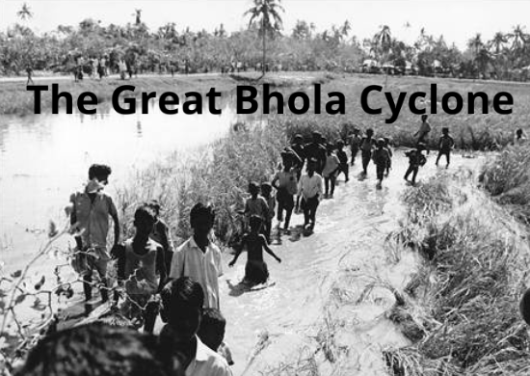
Pictures
November 12, 1970 – still deadliest tropical cyclone ever recorded
East Pakistan
Peak sustained winds 185 km/hr (115 mph)
500,000 – 1,000,000 dead
February 2, 2011 – queensland, Australia
Damages exceeded $3.6 billion
10,000 people forced out of their homes
Death of 23-0ld from suffocation

Slide 7
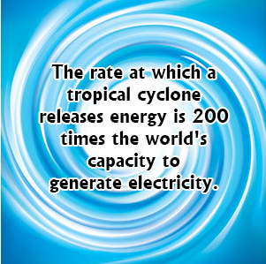
Facts
Cyclones cannot form near the equator because the Coriolis force near the equator is 0.
Cyclones are the most dangerous hazard to people
Cyclones spin clockwise in the southern hemisphere
The eye is the most calm place in a cyclone
A cyclone is given a name when its winds reach 89 kmph

